Slide 1

Topics to be Covered
Introduction to Object-Oriented programming
Features of Object-Oriented Programming
Features of Java
Difference between C++ and Java
JDK, JRE, JVM
JVM – Java Virtual Machine Architecture

Slide 2
Introduction to Object Oriented Programming

Slide 3
Introduction to Object Oriented Programming
There are three types of programming methodology :
Monolithic Programming
Procedure-oriented Programming
Object-oriented Programming
Monolithic Programming
It indicates the program which contains a single function for a large program.
A program is not divided into parts and hence is the name.
When the program size increases it leads inconvenience and is difficult to maintain.
The global data can be accessed and modified from any part of the program and hence posing a serious threat.
It is suitable to develop simple and small applications.
Example: Basic

Slide 4
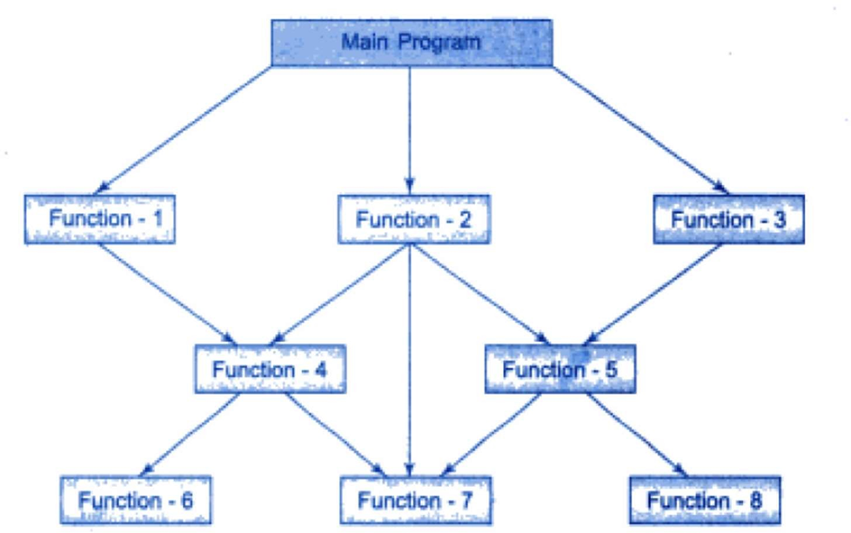
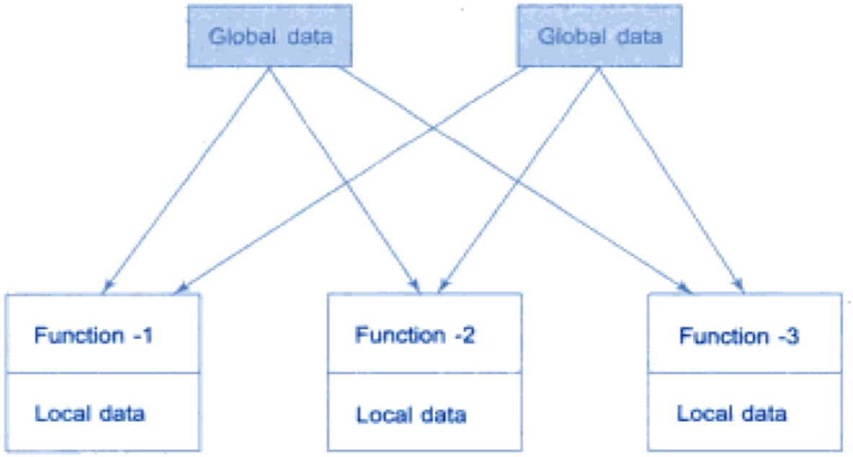
Introduction to Object Oriented Programming
Procedure Oriented Programming
It basically consists of writing a list of instructions organized into groups known as functions.
The primary focus is on function rather than data.
Larger programs are divided into smaller programs known as functions.
Most of the functions share global data.
Data moves openly around the system from function to function.
Examples: COBOL, Fortran, C
Structure of Procedure-oriented Programming
Relationship of Data and Functions

Slide 5
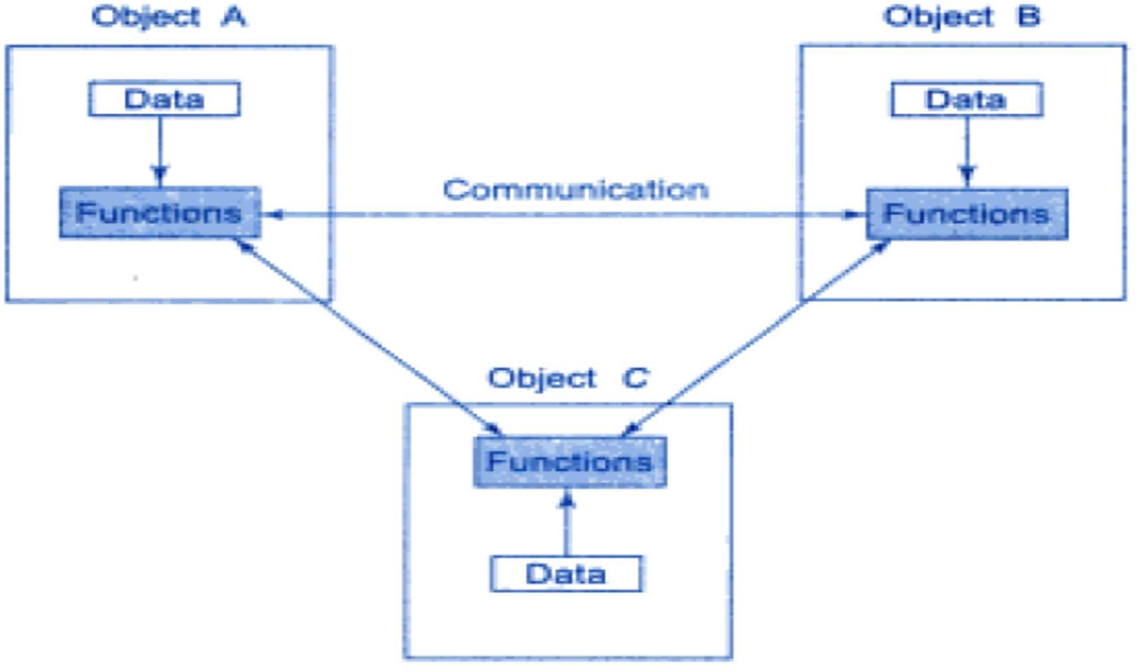
Introduction to Object Oriented Programming
Object Oriented Programming
OOP allows the decomposition of a problem into a number of entities called objects and then builds data and functions around these objects.
It treats data as a critical element in program development and does not allow it to flow freely around the system.
It ties data more closely to the functions that operate on it and protects it from accidental modification from outside functions.
The data of an object can be accessed only by the functions associated with that object.
Data is hidden and cannot be accessed by external functions.
Objects may communicate with each other through functions.
Example: C++, Java etc
Organization of data and function in OOP

Slide 6
Features of Object Oriented Programming

Slide 7
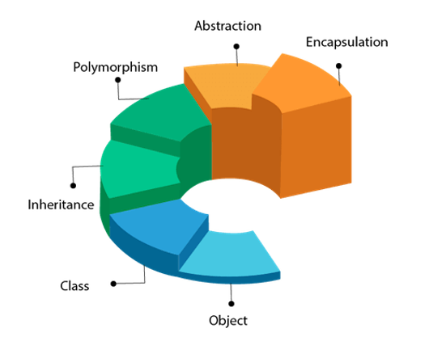
Features of Object Oriented Programming
The following are the basic features of Object Oriented Programming:
Object
Class
Abstraction
Encapsulation
Inheritance
Polymorphism

Slide 8
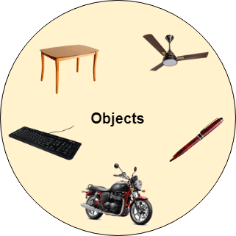
Features of Object Oriented Programming
Object:
Any entity that has a state and behavior is known as an object.
Example: A dog is an object because it has states like color, name, breed, etc. as well as behaviors like wagging the tail, barking, eating, etc.
An Object can be defined as an instance of a class. An object contains an address and takes up some space in memory.

Slide 9

Features of Object Oriented Programming
Class:
Collection of objects is called class. It is a logical entity.
A class can also be defined as a blueprint from which you can create an individual object. Class doesn't Abstraction
Abstraction:
Hiding internal details and showing functionality is known as abstraction. For example phone call, we don't know the internal processing.
In Java, we use abstract classes and interfaces to achieve abstraction.
Encapsulation:
Binding (or wrapping) code and data together into a single unit are known as encapsulation. For example, a capsule, it is wrapped with different medicines.
A Java class is an example of encapsulation.

Slide 10
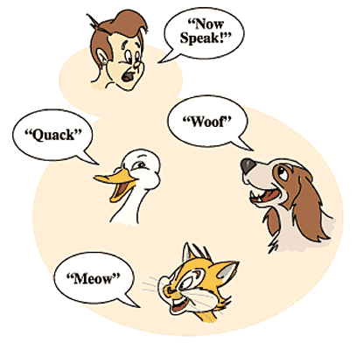
Features of Object Oriented Programming
Inheritance:
When one object acquires all the properties and behaviors of a parent object, it is known as inheritance.
Polymorphism:
If one task is performed in different ways, it is known as polymorphism. For example: to convince the customer differently, to draw something, for example, shape, triangle, rectangle, etc.
In Java, we use method overloading and method overriding to achieve polymorphism.
Another example can be to speak something; for example, a cat speaks meow, a dog barks woof, etc.

Slide 11
Features of Java

Slide 12
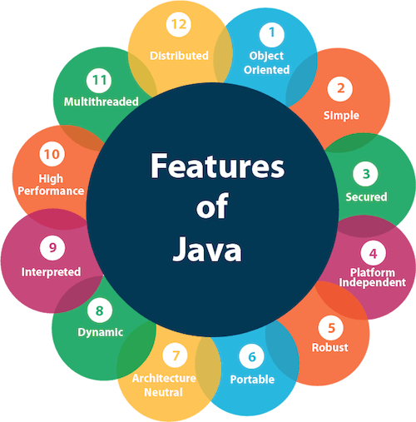
Features of Java
Features of Java:
A list of the most important features of the Java language is given below.
Object-Oriented
Simple
Secured
Platform independent
Robust
Portable
Architecture Neutral
Dynamic
Interpreted
High Performance
Multithreaded
Distributed

Slide 13
Features of Java
1) Object Oriented:
Java is an object-oriented programming language. Everything in Java is an object. Object-oriented means we organize our software as a combination of different types of objects that incorporate both data and behavior.
Object-oriented programming (OOPs) is a methodology that simplifies software development and maintenance by providing some rules.
2) Simple:
Java is very easy to learn, and its syntax is simple, clean, and easy to understand.
Java syntax is based on C++ (so easier for programmers to learn it after C++).
Java has removed many complicated and rarely-used features, for example, explicit pointers, operator overloading, etc.
There is no need to remove unreferenced objects because there is an Automatic Garbage Collection in Java.

Slide 14
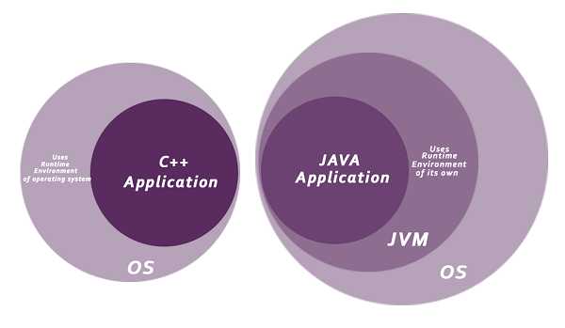
Features of Java
3) Secured:
Java is best known for its security. With Java, we can develop virus-free systems.
No explicit pointer
Java Programs run inside a virtual machine sandbox

Slide 15
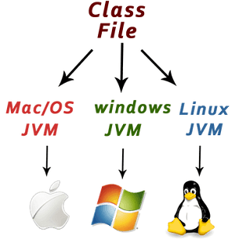
Features of Java
4) Platform Independent:
A platform is the hardware or software environment in which a program runs.
Java is platform-independent because, Java code can be executed on multiple platforms, for example, Windows, Linux, Sun Solaris, Mac/OS, etc.
Java code is compiled by the compiler and converted into bytecode (class file). This bytecode is a platform-independent code because it can be run on multiple platforms, i.e., Write Once and Run Anywhere (WORA).

Slide 16
Features of Java
5) Robust:
It uses strong memory management.
Java provides automatic garbage collection which runs on the Java Virtual Machine to get rid of objects which are not being used by a Java application anymore.
There are exception handling and type checking mechanisms in Java.
6) Portable:
Java is portable because it facilitates you to carry the Java bytecode to any platform. It doesn't require any implementation.
7) Architectural Neutral:
Java is architecture neutral because there are no implementation-dependent features, for example, the size of primitive types is fixed.
In C programming, int data type occupies 2 bytes of memory for 32-bit architecture and 4 bytes of memory for 64-bit architecture. However, it occupies 4 bytes of memory for both 32 and 64-bit architectures in Java.

Slide 17
Features of Java
8) Dynamic:
Java is a dynamic language. It supports the dynamic loading of classes. It means classes are loaded on demand. It also supports functions from its native languages, i.e., C and C++.
Java supports dynamic compilation and automatic memory management (garbage collection).
9) Interpreted:
Java is both compiled and interpreted language.
Java code is first compiled into byte-code and later it is interpreted by JVM for execution.
10) High Performance:
Java is faster than other traditional interpreted programming languages because Java bytecode is "close" to native code.
It is still a little bit slower than a compiled language (e.g., C++). Java is an interpreted language that is why it is slower than compiled languages, e.g., C, C++, etc..

Slide 18
Features of Java
11) Multithreaded:
A thread is like a separate program, executing concurrently.
We can write Java programs that deal with many tasks at once by defining multiple threads.
The main advantage of multi-threading is that it doesn't occupy memory for each thread. It shares a common memory area.
Threads are important for multi-media, Web applications, et.
12) Distributed:
Java is distributed because it facilitates users to create distributed applications in Java.
RMI and EJB are used for creating distributed applications.
This feature of Java makes us able to access files by calling the methods from any machine on the internet.

Slide 19
Difference between C++ and Java

Slide 20
Difference between C++ and Java
Comparison Index | C++ | JAVA
Platform-independent | C++ is platform-dependent. | Java is platform-independent.
Goto | C++ supports the goto statement. | Java doesn’t support the goto statement.
Pointers | C++ supports pointers. You can write a pointer program in C++. | Java supports pointer internally. However, you can't write the pointer program in java. It means java has restricted pointer support in java.
Operator Overloading | C++ supports operator overloading. | Java doesn't support operator overloading.
Multiple inheritance | C++ supports multiple inheritance. | Java doesn't support multiple inheritance through class. It can be achieved by using interfaces in java.
Structure and Union | C++ supports structures and unions. | Java doesn't support structures and unions.
Thread Support | C++ doesn't have built-in support for threads. | Java has built-in thread support.

Slide 21
JDK, JRE and JVM

Slide 22
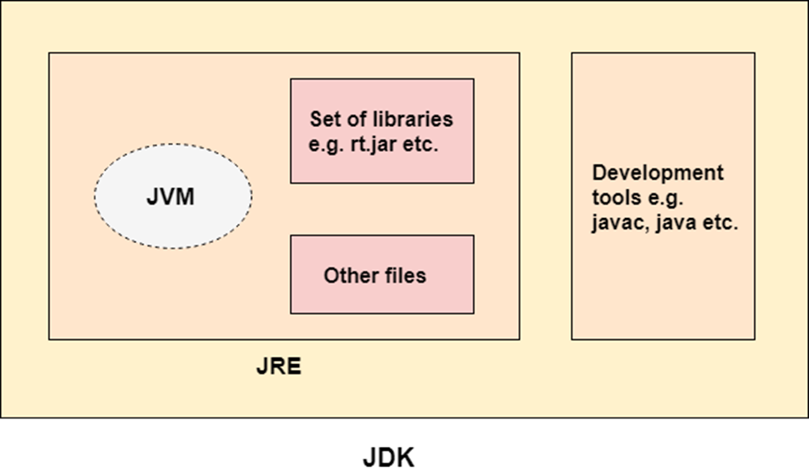
JDK, JRE and JVM

Slide 23
JDK, JRE and JVM
JDK
JDK is an acronym for Java Development Kit.
The Java Development Kit (JDK) is a software development environment that is used to develop Java applications and applets. It physically exists and it contains JRE + development tools.
JDK is an implementation of any one of the below given Java Platforms released by Oracle Corporation:
Standard Edition Java Platform
Enterprise Edition Java Platform
Micro Edition Java Platform
The JDK contains a private Java Virtual Machine (JVM) and a few other resources such as an interpreter/loader (java), a compiler (javac), an archiver (jar), a documentation generator (Javadoc), etc. to complete the development of a Java Application.

Slide 24
JDK, JRE and JVM
JRE
JRE is an acronym for Java Runtime Environment.
It is also written as Java RTE.
The Java Runtime Environment is a set of software tools that are used for developing Java applications.
It is used to provide the runtime environment. It is the implementation of JVM.
It physically exists. It contains a set of libraries + other files that JVM uses at runtime.
The implementation of JVM is also actively released by other companies besides Sun Micro Systems.

Slide 25
JDK, JRE and JVM
JVM
JVM (Java Virtual Machine) is an abstract machine. It is called a virtual machine because it doesn't physically exist.
It is a specification that provides a runtime environment in which Java bytecode can be executed. It can also run those programs which are written in other languages and compiled to Java bytecode.
JVMs are available for many hardware and software platforms. JVM, JRE, and JDK are platform dependent because the configuration of each OS is different from each other.
The JVM performs the following main tasks:
Loads code
Verifies code
Executes code
Provides a runtime environment

Slide 26
Java Virtual Machine ( JVM) Architecture

Slide 27
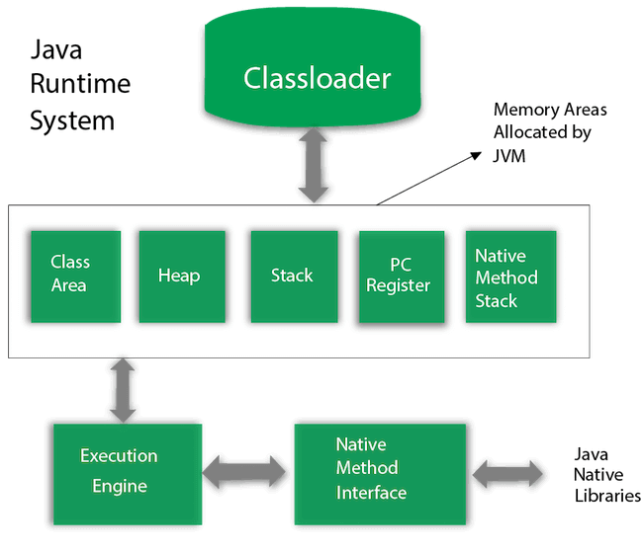
JVM Architecture
JVM (Java Virtual Machine) is an abstract machine. It is a specification that provides a runtime environment in which Java bytecode can be executed.
JVMs are available for many hardware and software platforms (i.e. JVM is platform dependent).

Slide 28
JVM Architecture
1) Classloader:
Classloader is a subsystem of JVM that is used to load class files. Whenever we run the java program, it is loaded first by the classloader. .
2) Class Area:
Class(Method) Area stores per-class structures such as the runtime constant pool, field and method data, and the code for methods.
3) Heap:
It is the runtime data area in which objects are allocated.
4) Stack:
Java Stack stores frames. It holds local variables and partial results and plays a part in method invocation and return.
5) PC Register:
PC (program counter) register contains the address of the Java virtual machine instruction currently being executed.

Slide 29
JVM Architecture
6) Native Method Stack:
It contains all the native methods used in the application.
7) Execution Engine:
It contains:
A virtual processor
Interpreter: Read bytecode stream then execute the instructions.
Just-In-Time(JIT) compiler:
It is used to improve performance.
JIT compiles parts of the byte code that have similar functionality at the same time and hence reduces the amount of time needed for compilation.
Here, the term "compiler" refers to a translator from the instruction set of a Java virtual machine (JVM) to the instruction set of a specific CPU.
8) Java Native Interface:
Java Native Interface (JNI) is a framework that provides an interface to communicate with another application written in another language like C, C++, Assembly etc. Java uses the JNI framework to send output to the Console or interact with OS libraries.

Slide 30
Thank You

